Slide 1
iCue
One-Click Reports & Personalized Learning
2013-14

Slide 2
What are One-Click Reports?
View and analyze student performance across many assessment scores
Can include any assessment (state tests, NWEA, local assessments, formative and summative, etc.)
See students in your classes, and view students by subgroup
Many tools available to help you understand the data (graphical reports, color-coding compared to targets, filter by performance level, and drill in to see supporting resources)

Slide 3
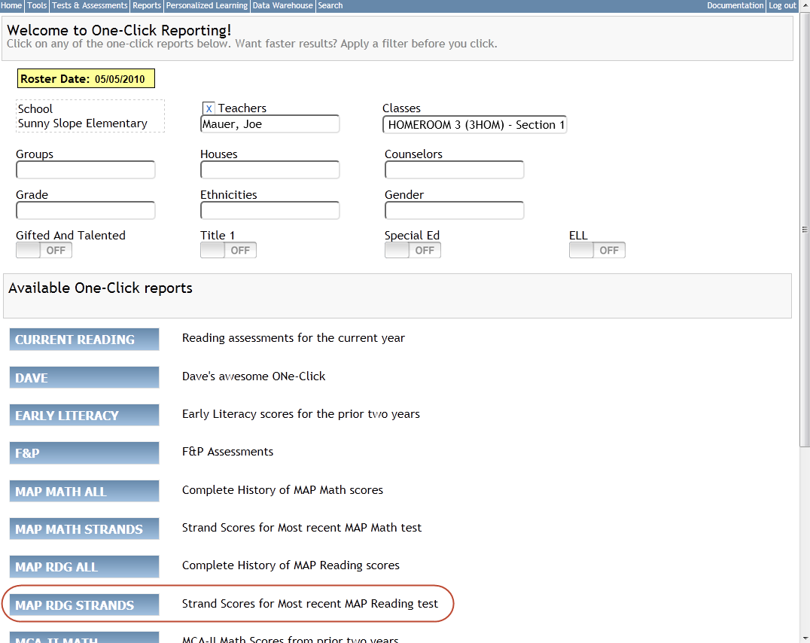
Example One-Click home page

Slide 4
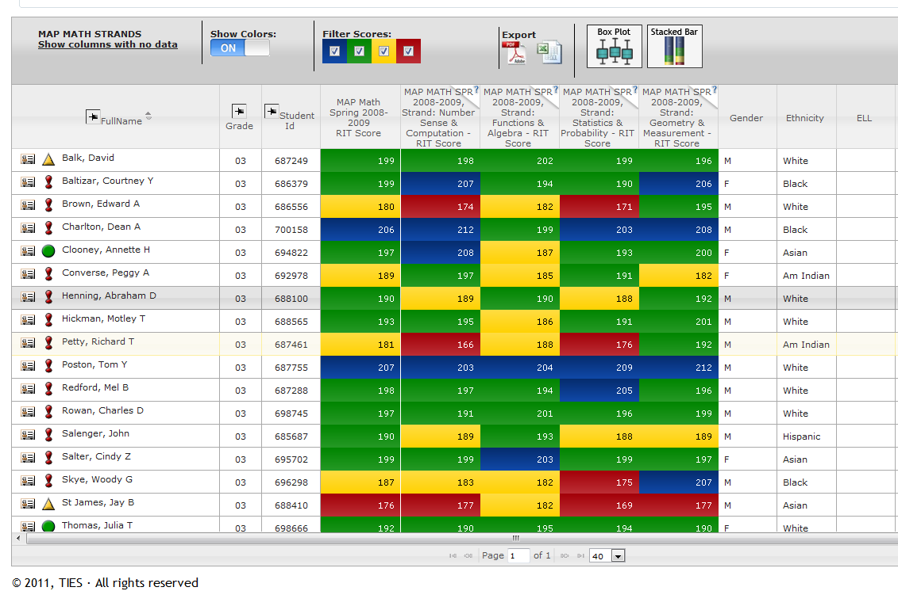
Example One-Click Report

Slide 5
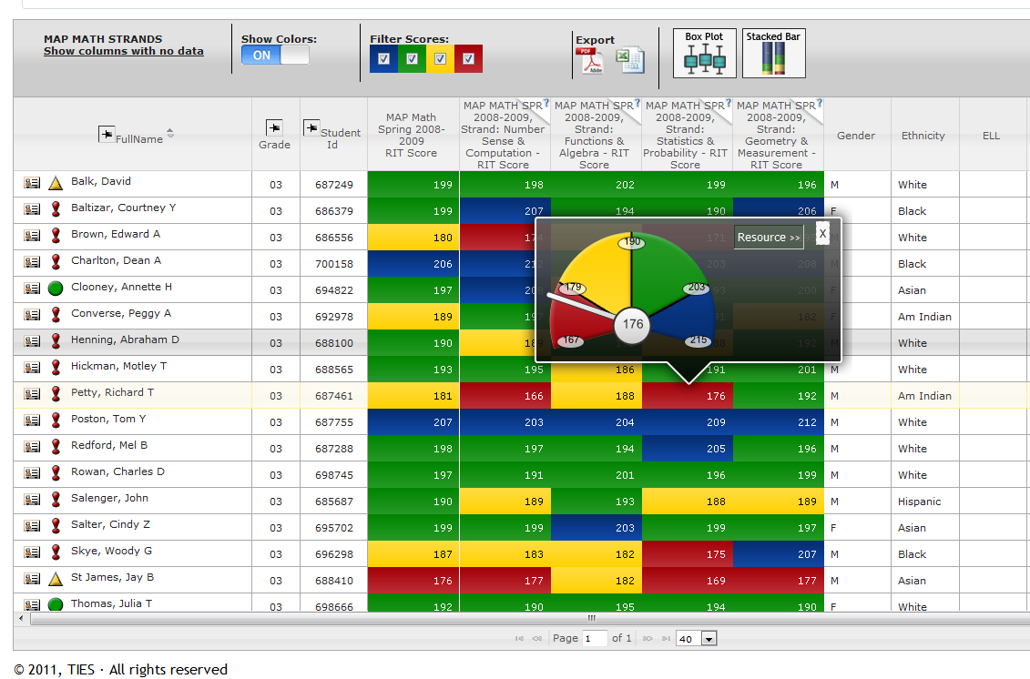
Compare to Target and Drill-through to Resource

Slide 6
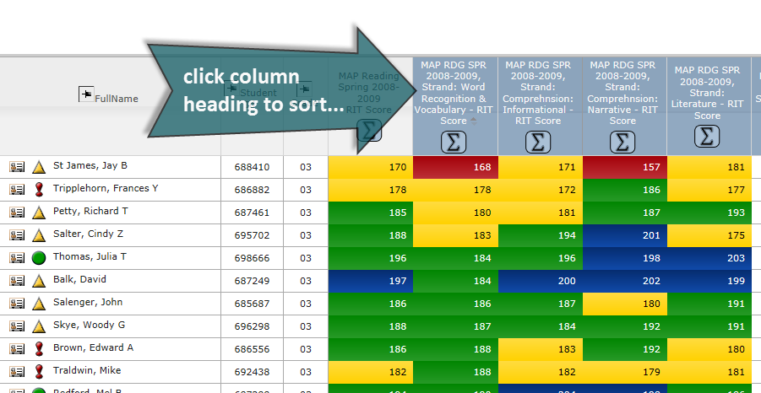
Sortable results

Slide 7
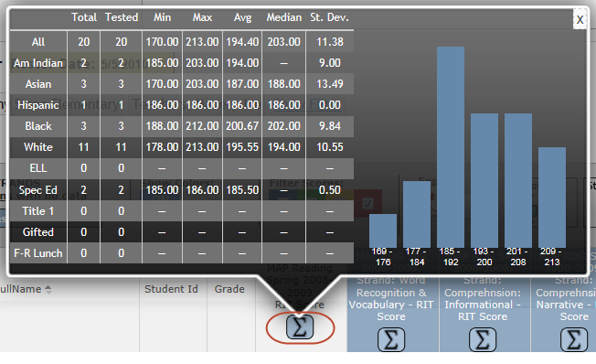
Summary statistics

Slide 8
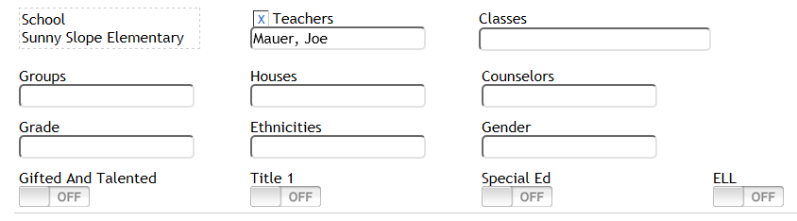
Available Filters

Slide 9
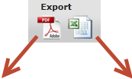
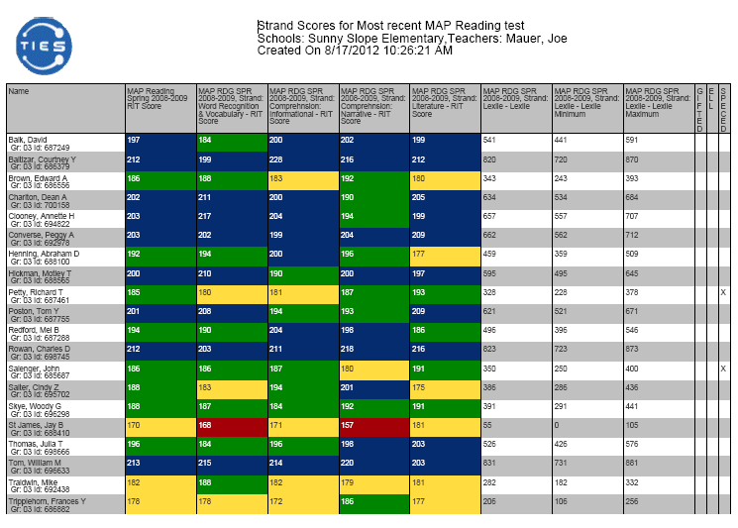
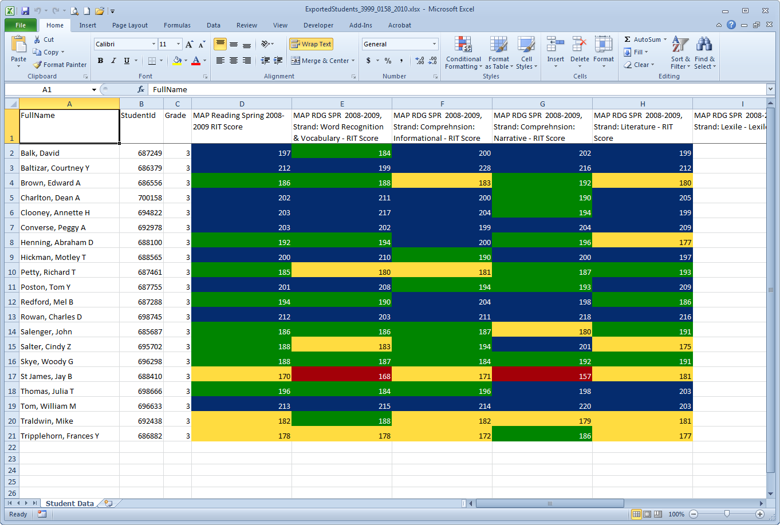
Export options

Slide 10
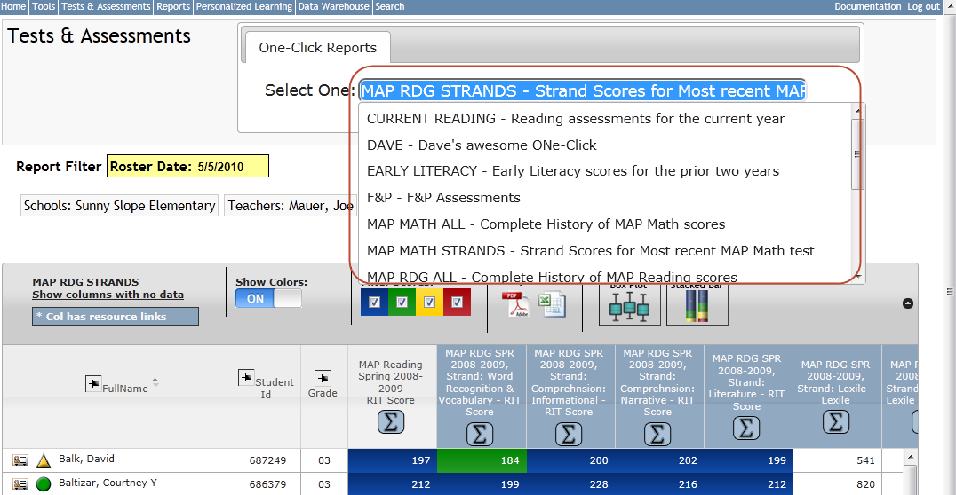
You can run a new One-Click by selecting from the drop-down menu

Slide 11
Helpful Reminders –
One-Click Reports
Roster Date…why do I need to change this date?
It is before school starts (first day of students)
You want to see how your class did last year on the MCA assessments
Once school starts, you will always get the currently enrolled students in your roster without changing this date.

Slide 12
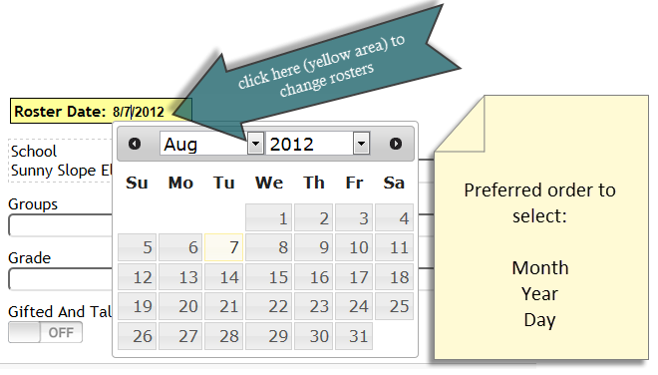
Helpful Reminders
Roster Date in One-Click Reports

Slide 13
What is Personalized Learning?
Profile:
A summary of student performance across many domains
An indicator of a student’s current status (point-in-time “snapshot”)
Specific measures within each domain determine status
A method of communicating performance efficiently at many levels, from the individual student to the entire school

Slide 14
Profile: Domains
Attendance
Behavior
Grades
Test Scores
Graduation On-Track

Slide 15

How does Profile work?
Schools choose which domains and measures they would like to track
Schools choose the target scores for each measure
Targets divide students into up to four groups on each measure:

Slide 16
How does Profile work?
Icons represent student performance on each measure
Domain-level icons represent the lowest performance level of any measure in the domain
Overall icons represent the lowest performance level of any domain
Icons update nightly

Slide 17
How does Profile work?
Overall icons are displayed throughout iCue, next to student’s name
Class profile summarizes performance across domains and measures for the class
Student profile summarizes performance across all domains and measures, for an individual student

Slide 18
Example One-Click Report

Slide 19
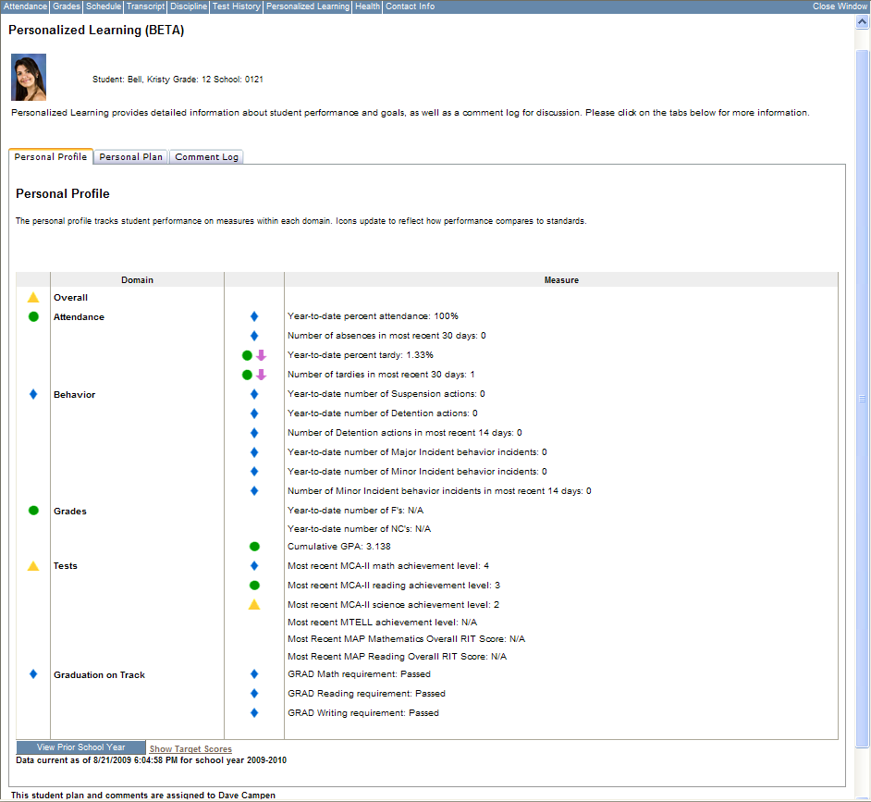
Individual Student Profile
Copyright © 2009, TIES
Notes:
19
This is just the start – profile lets teacher go beyond test scores, gives background to help develop relationships and identify areas of concern
Jefferson meetings between advisors and students – looping homerooms and ongoing relationship

Slide 20
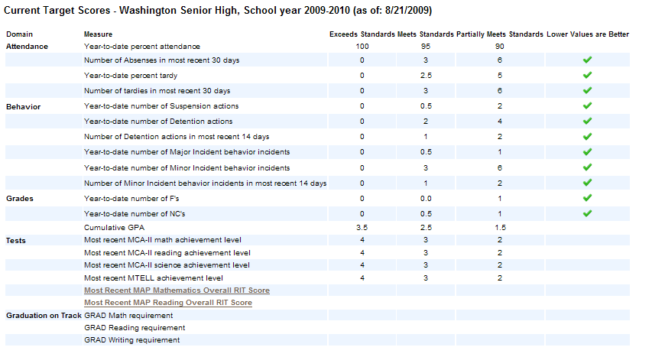
Show Target Scores

Slide 21
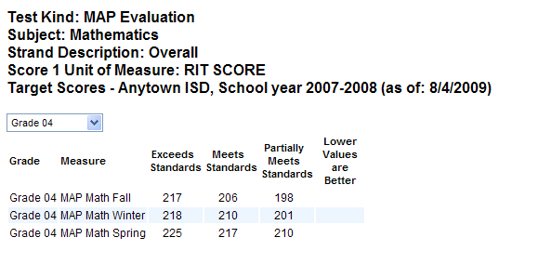
Show Target Scores - Tests

Slide 22
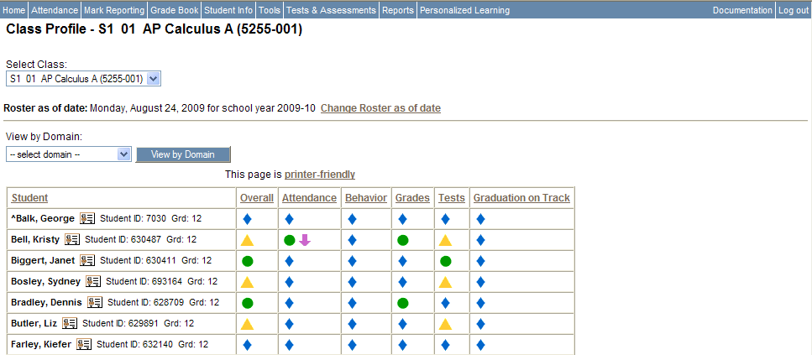
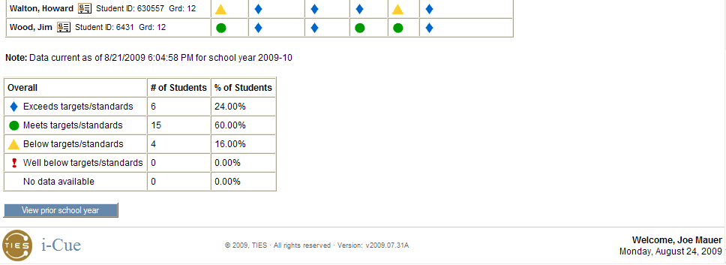
Class Profile

Slide 23
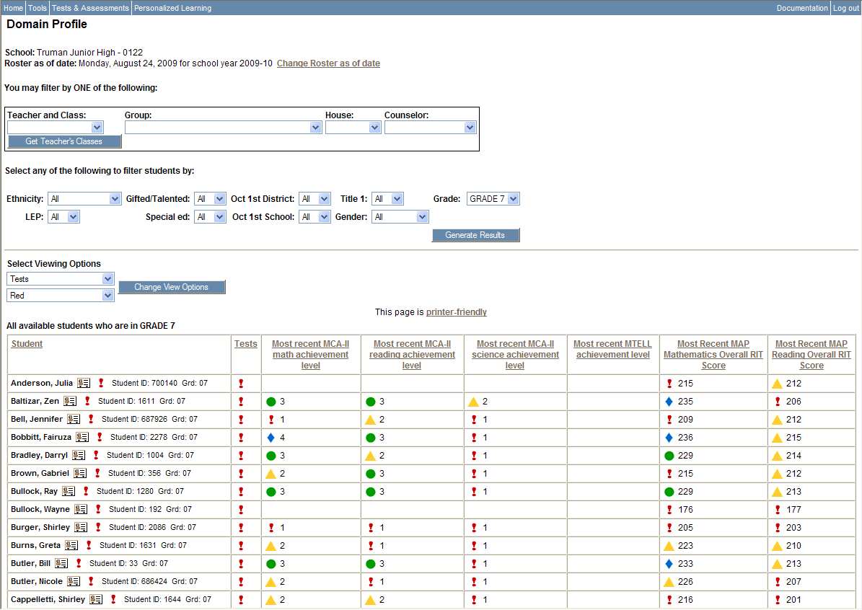
Domain Profile

Slide 24
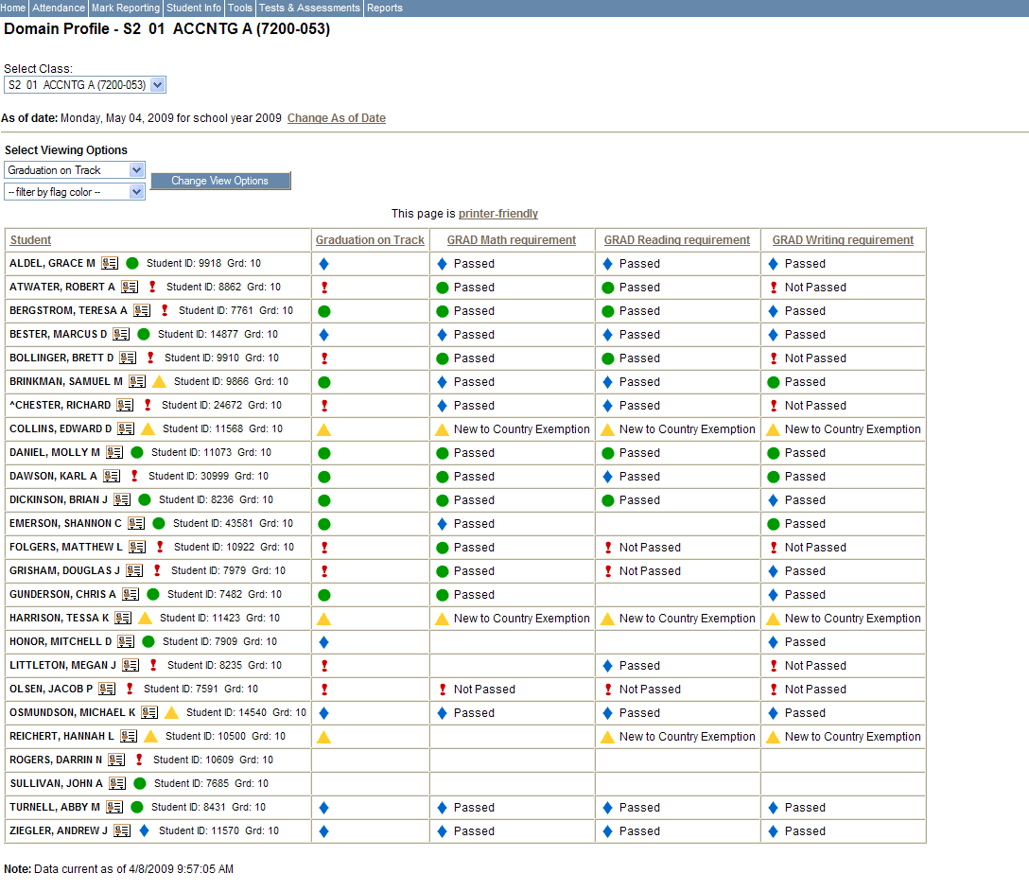
Graduation on Track – teacher view

Slide 25
What is Personalized Learning?
Plan:
Develop personal learning plans for any student
Communicate information between and among staff, students, and parents
Set goals, establish activities, and measurement plans to track success
Allow many people to collaborate on the plan
Threaded discussion enhances communication among contributors

Slide 26
How does Plan work?
Develop goals, and match goals to profile domains
Set activities and measurement plans for each goal
Use “school bank” to quickly assign common plan components
Time-bound and measurable
School bank can add growth goals and test scores specific to the student

Slide 27
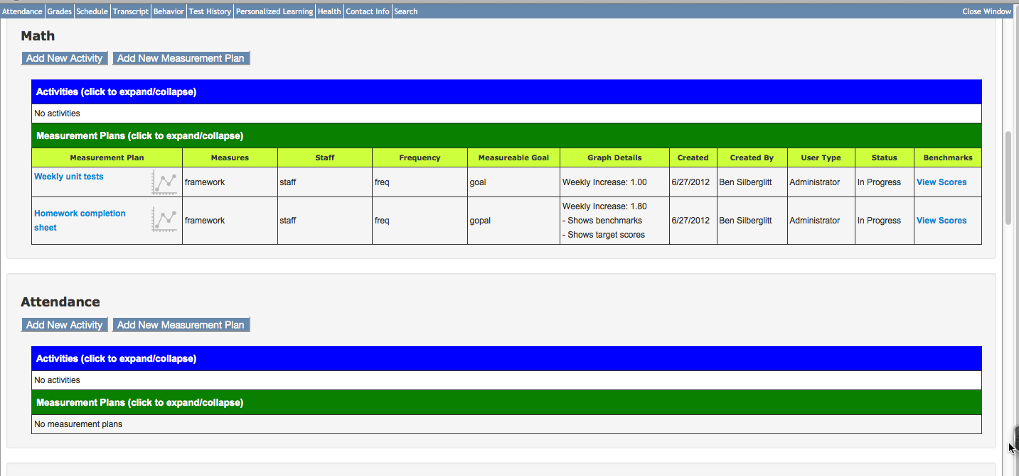
Personalized Learning Plan – Example Student

Slide 28
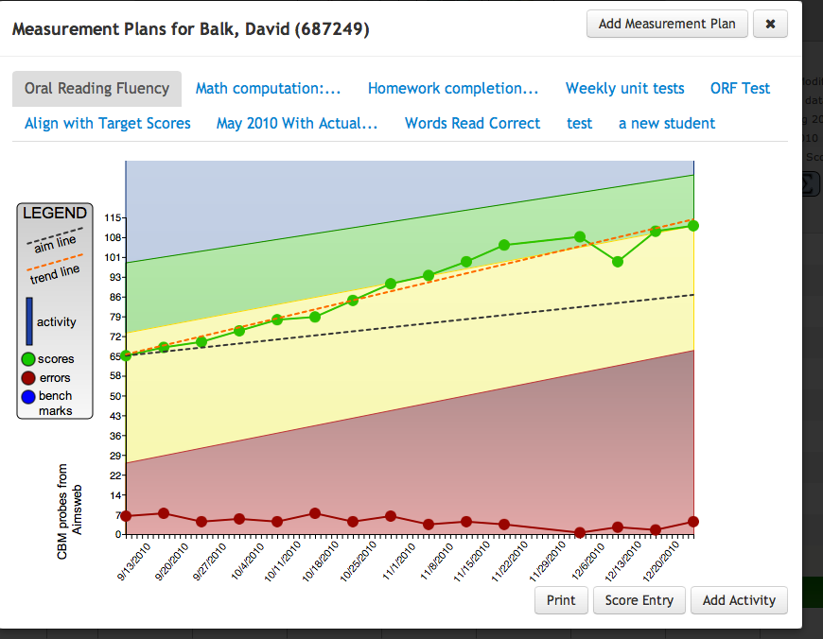
Example – Student Measurement Plan Graph

Slide 29
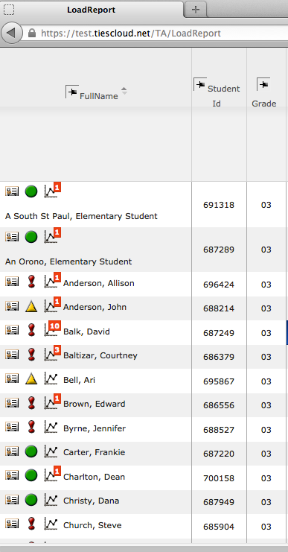
New Measurement Plan icon

Slide 30
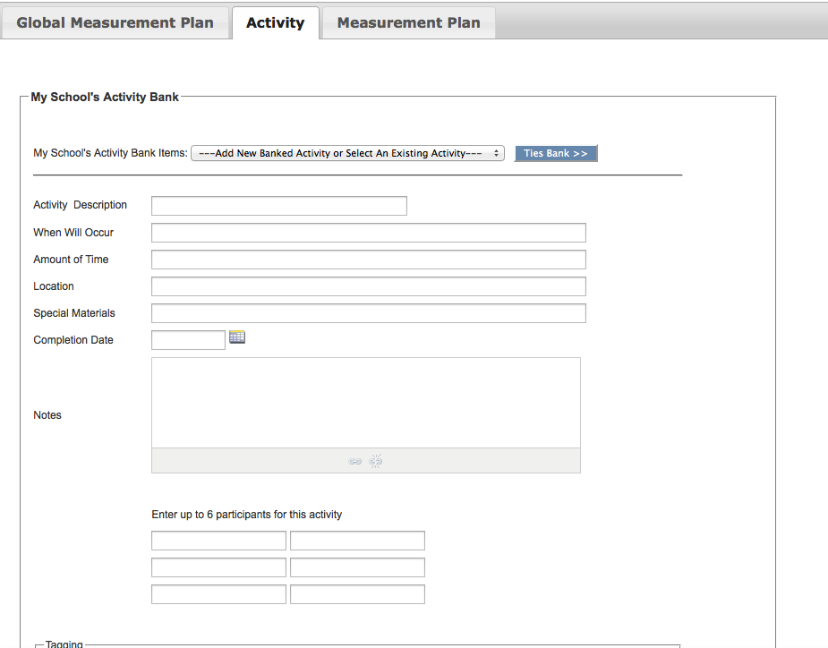
Ability to Create Banked Activities and Measurement Plans or by Individual Students

Slide 31
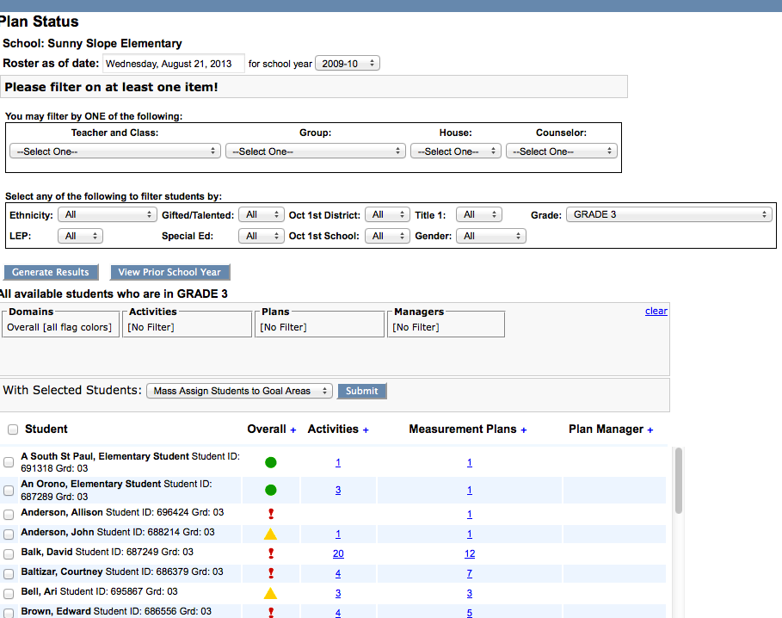
Ability to Filter and Mass Assign Activities and Measurement Plans

Slide 32
To Summarize…
One Click Reports are used for:
  viewing student performance on test and assessment scores,
  score entry for a group or roster of students,
  viewing the Student Link (Test History, Contact)
Personalized Learning Profiles are used to help you measure other indicators of student success such as Attendance or Grades
Personalized Learning Plans are used for developing individual intervention strategies and/or measurement plans based on student needs.

Slide 33
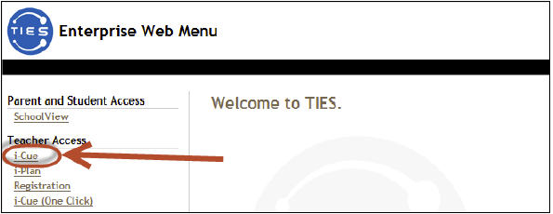
How to Log In
Go to http://asp.tiescloud.net
Click the link and the bottom of the page to add this to your bookmarks
Select i-Cue

Slide 34
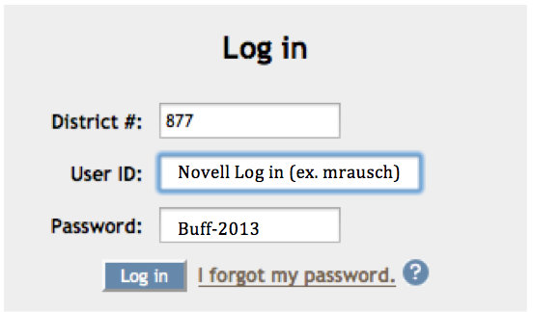
Log In Information
District #: 877
User ID: Your Novell log in
Temporary Password: Buff-2013

Slide 35
Change Your Password
You will be prompted to change your password.
You may use the same password as your MyView but it will not automatically select this.
Password must be 8 characters long, use an uppercase letter and a special character (ex. ! @ # $ % ^ &)

Slide 36
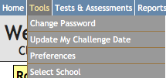
Setup Challenge Date
At the top of your screen; Select “Tools” and then “Update My Challenge Date”.
Enter a challenge date.
Make sure this is a date you will remember! Ex. Your birthday, your anniversary, a child’s birthday.

Slide 37
Questions?

